Slide 1

Basic course4 - Button
Yahboom
Yahboom OMIBOX Tutorial

Slide 2
1
2
3
4
5
Learning
goals
Search for
blocks
Combine
blocks
Experimental
phenomena
Preparation
程序编程
Tencent
Yahboom OMIBOX Tutorial

Slide 3
1
Preparation-1
1. The position of the button in the robot car
2. Learn how to control buttons by graphically programming
Yahboom OMIBOX Tutorial

Slide 4
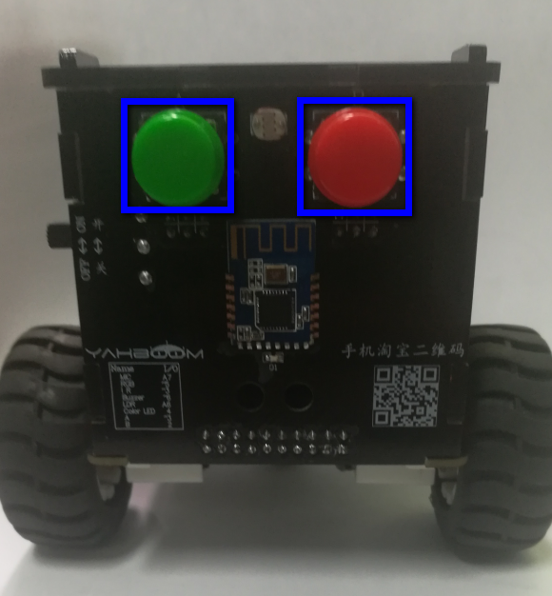
1
Preparation-1
As shown in the figure above,we circled the blue wire frame with two buttons, and we can control them by programming.
Yahboom OMIBOX Tutorial

Slide 5
2
Learning goals
In this lesson, we will learn how to use the buttons. When the red button is pressed, all the lights be lit up. When the green button is pressed, all the lights be closed.
Yahboom OMIBOX Tutorial

Slide 6
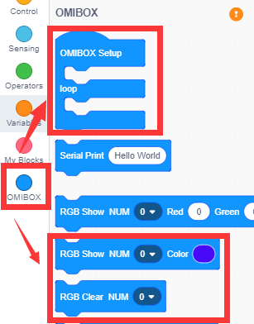
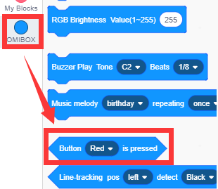
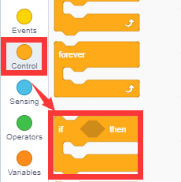
3
Search for blocks
The following is the location of the building blocks required for this programming.
Yahboom OMIBOX Tutorial

Slide 7
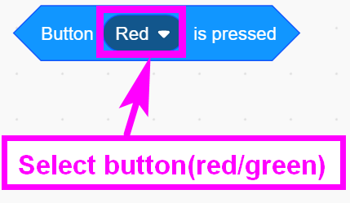
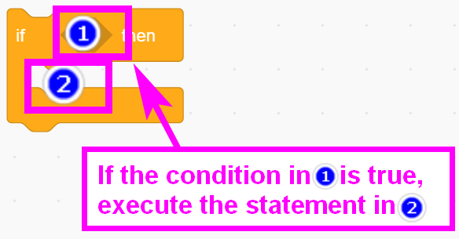
3
Search for blocks
Yahboom OMIBOX Tutorial

Slide 8
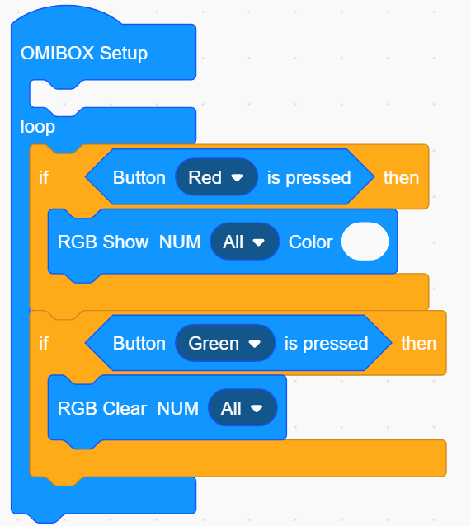
4
Combine blocks
The summary program is shown below:
Yahboom OMIBOX Tutorial

Slide 9
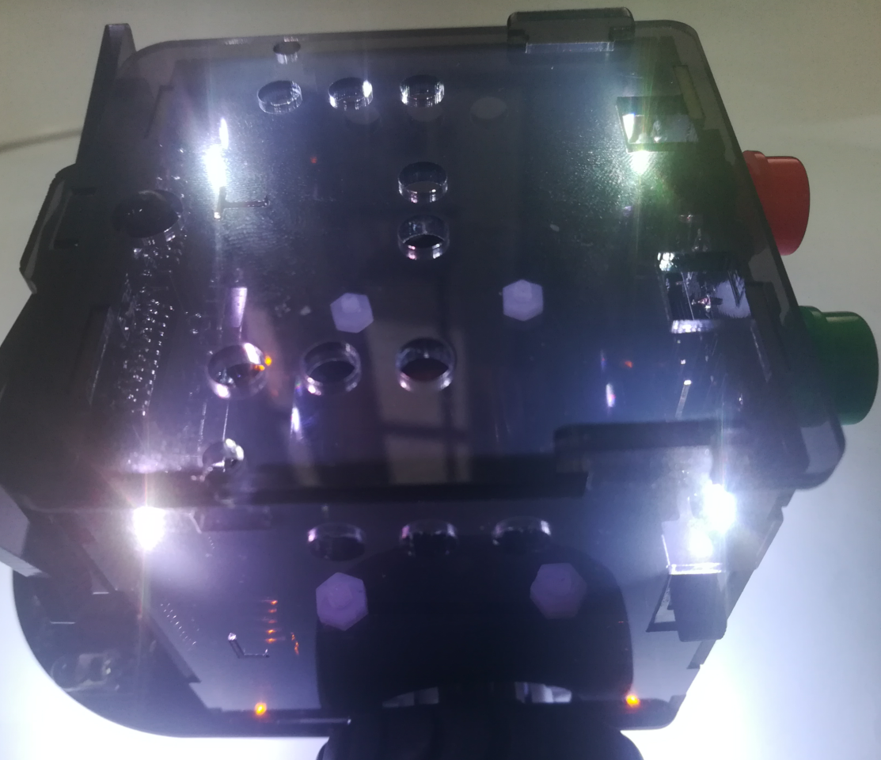
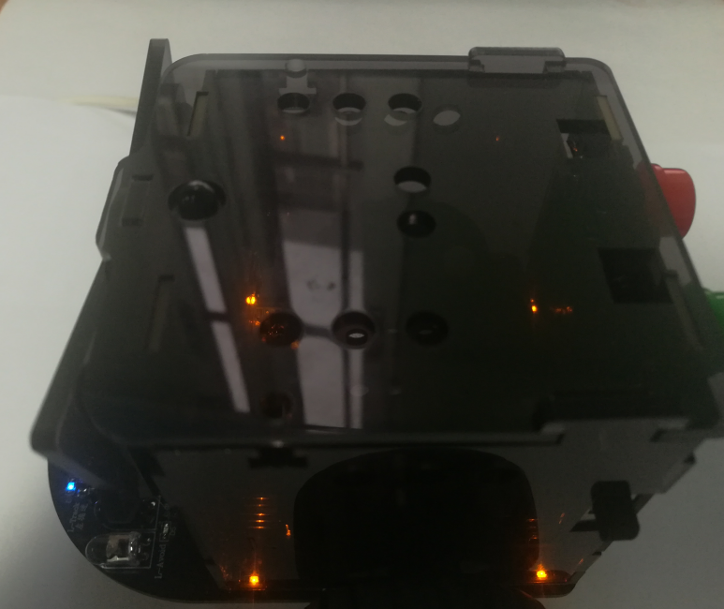
5
Experimental phenomena
After the program is uploaded, the car is powered on normally. When we press the red button, we can see that the RGB lights are lit. When we press the green button, we can see that the lights are off, as shown below:
Yahboom OMIBOX Tutorial

Slide 10
Inspire Creativity Embrace Innovation
Thank you!!!
Yahboom

